Slide 1
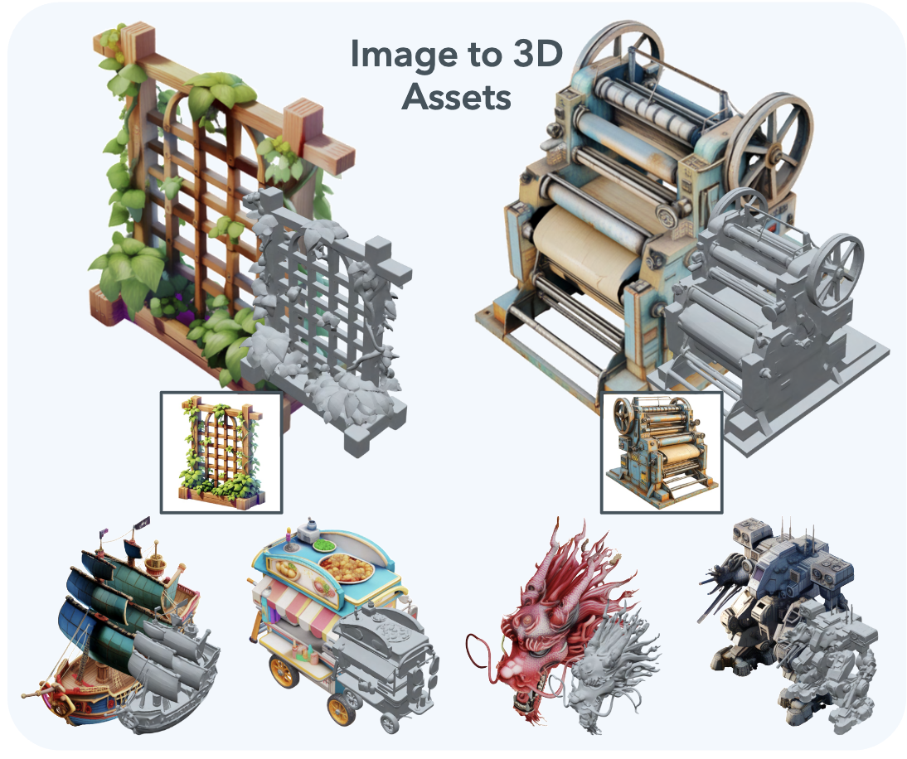
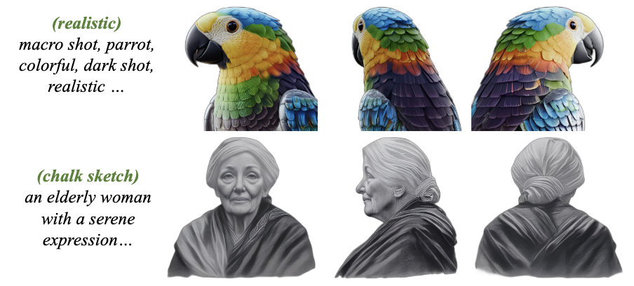
Advances of 3D AIGC
Typical Technicals
2D Diffusion Models:
Multi-view Diffusion Model
3D Diffusion Models:
3D Primitive Generation

Slide 2
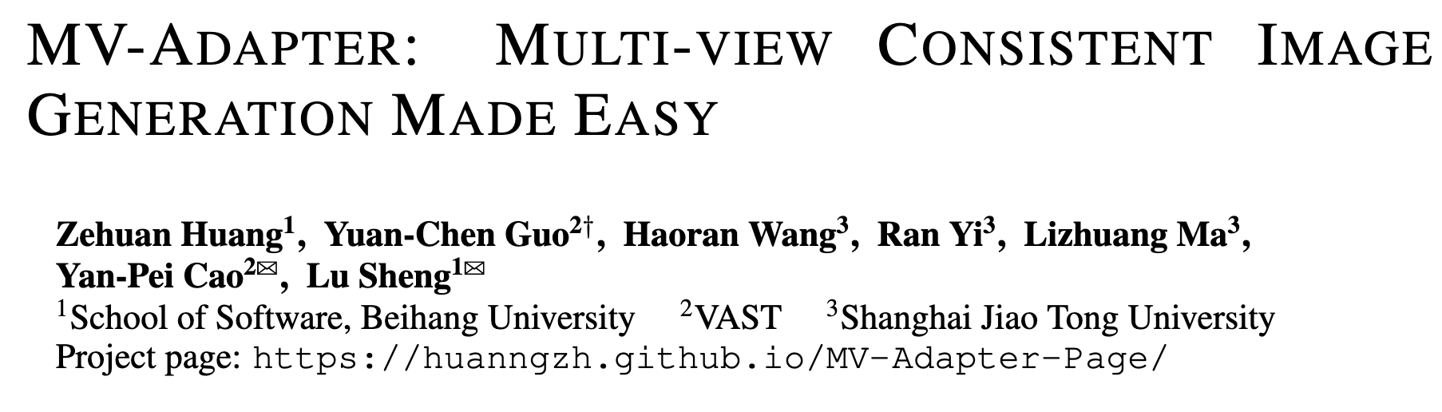
MV-Adapter
Arxiv2412

Slide 3
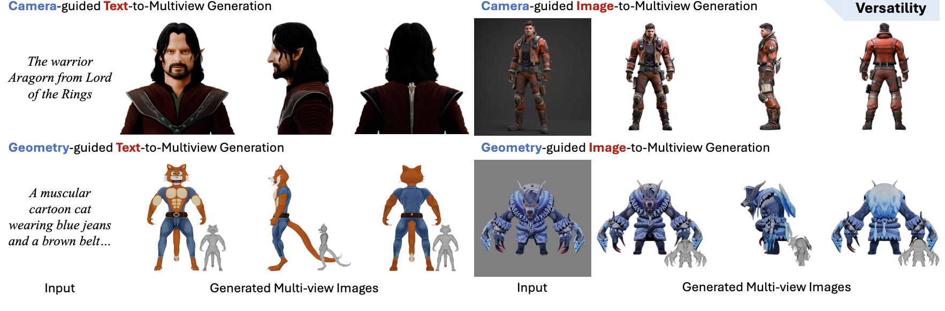
MV-Adapter
Arxiv2412
Setting: Given a text or an image, generate the corresponding multi-view images
Motivation:
Previous multi-view diffusion models make invasive modifications to t2i diffusion models and need to be fully finetuned.
This paper instead designs an adapter-based method to reduce computation cost and preserves the prior of t2i diffusion models.

Slide 4
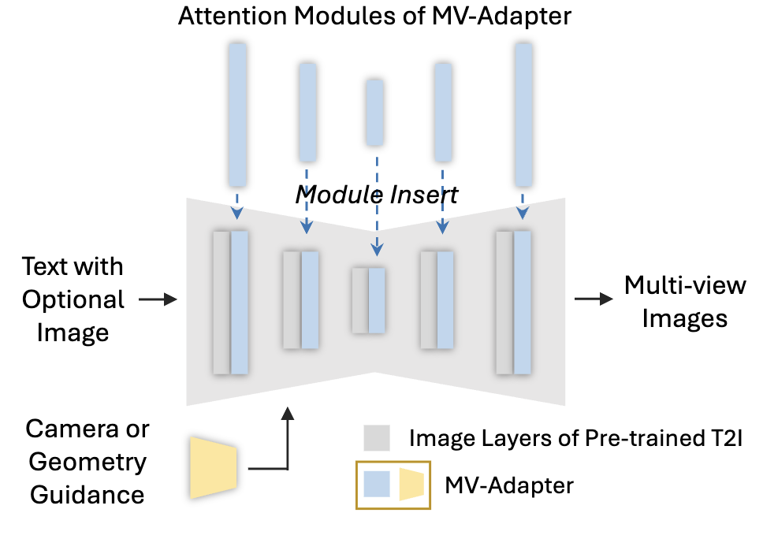
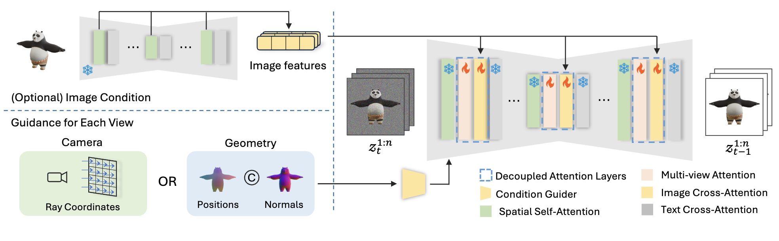
MV-Adapter
Arxiv2412
Methods:
- Overall Pipeline

Slide 5
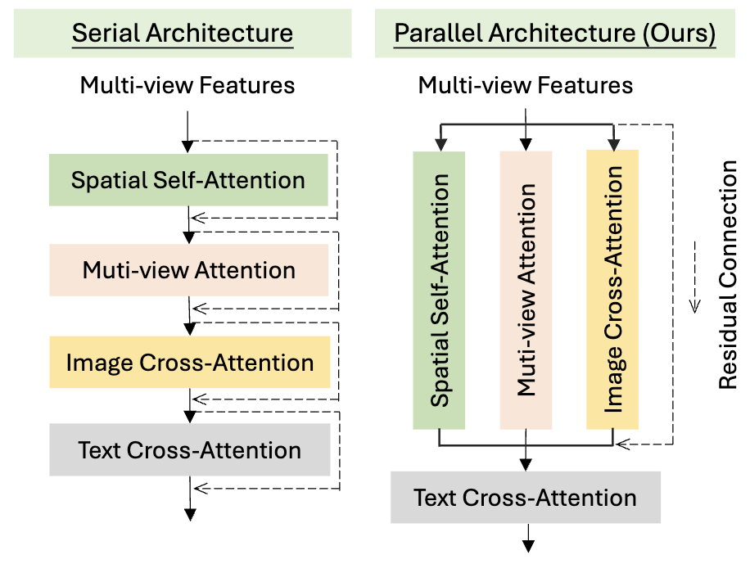
MV-Adapter
Arxiv2412
Methods:
- Multi-view Attention and Image Cross-Attention

Slide 6
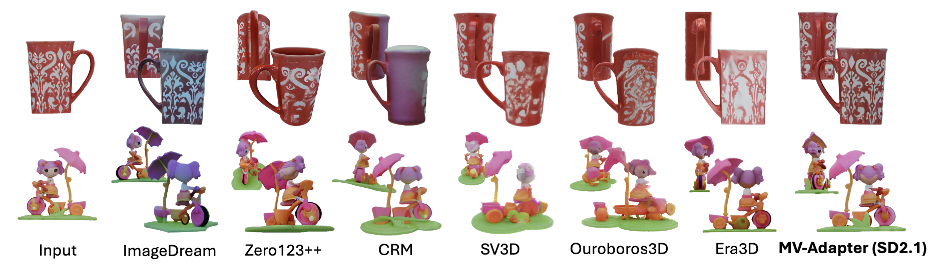
MV-Adapter
Arxiv2412
Results:

Slide 7
MV-Adapter
Arxiv2412
Limitations:
1. Limited to the 6 fixed camera viewpoints.
2. Failed to solve the inconsistency issue of multi-view diffusion models.

Slide 8
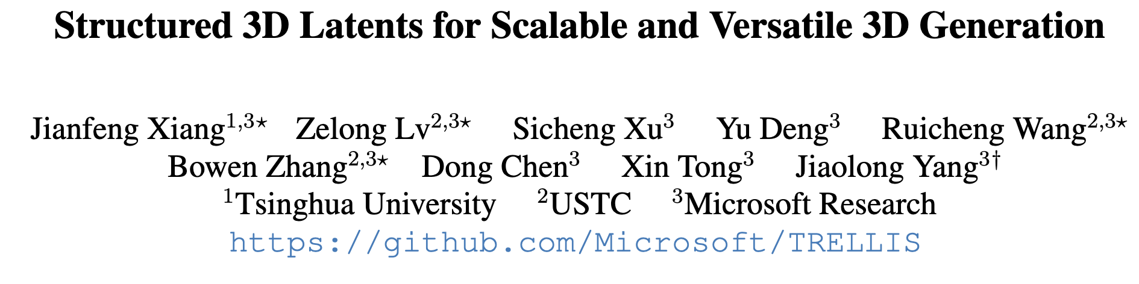
TRELLIS
CVPR25 SpotLight

Slide 9
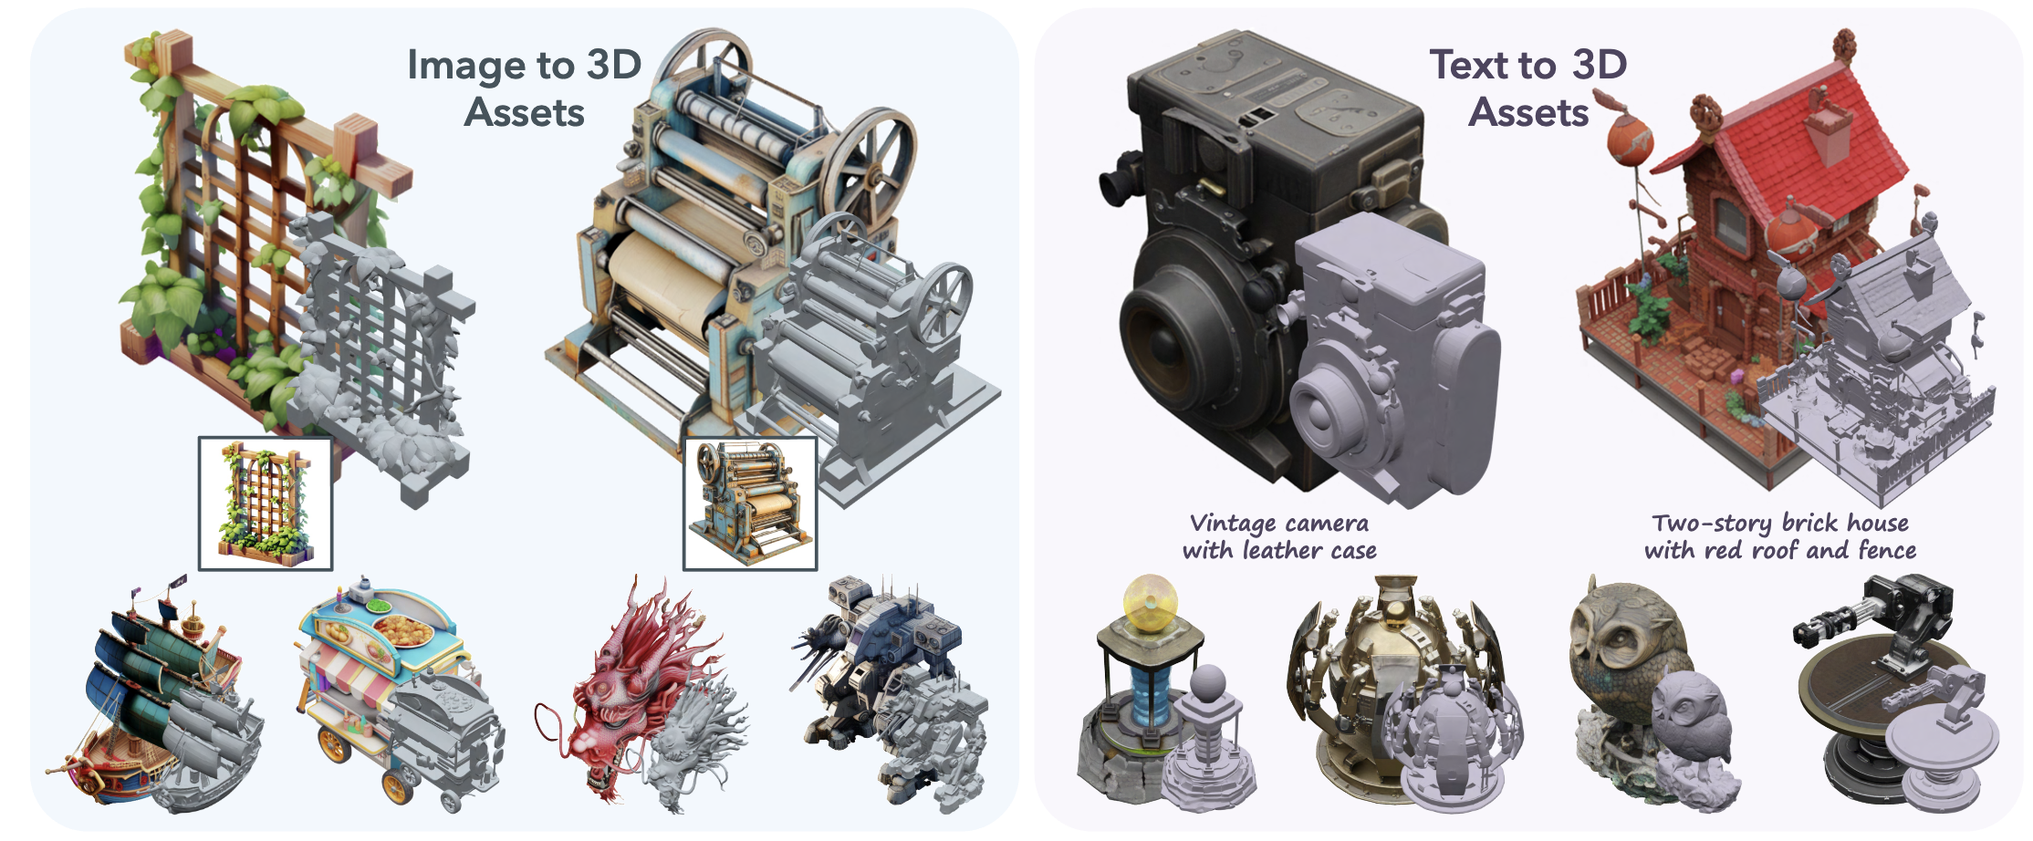
TRELLIS
CVPR25 SpotLight
Setting: Given a text or an image, generate the corresponding 3D assets (3DGS, RF, Mesh)
Setting: Introduce a novel 3D generation method based on the structed latent representation

Slide 10
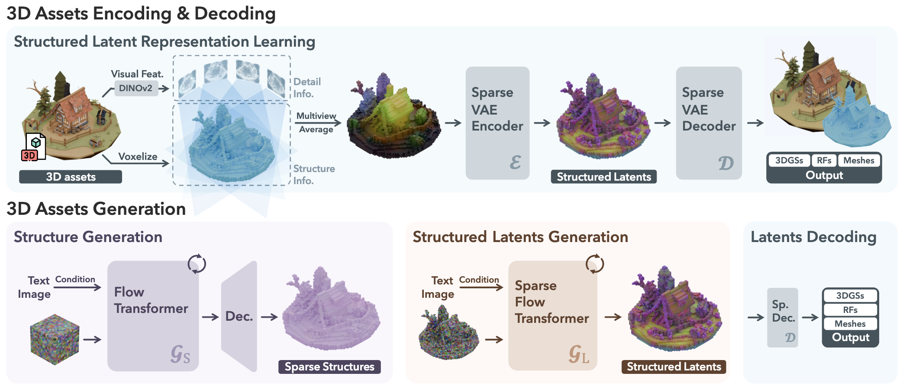
TRELLIS
CVPR25 SpotLight
Methods: Overall Pipeline
3D-VAE: Encode 3D assets into latent space for learning and saving computation cost
Flow Transformer: Transformer-based denoiser for flow matching

Slide 11
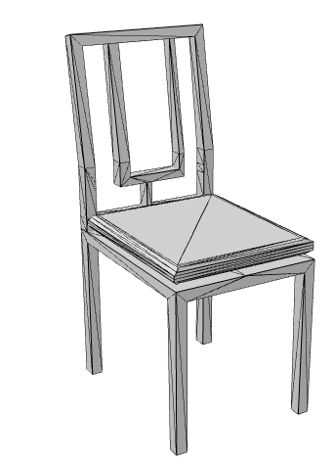
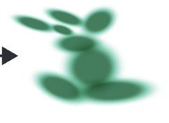
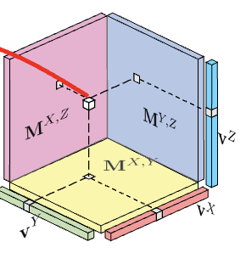
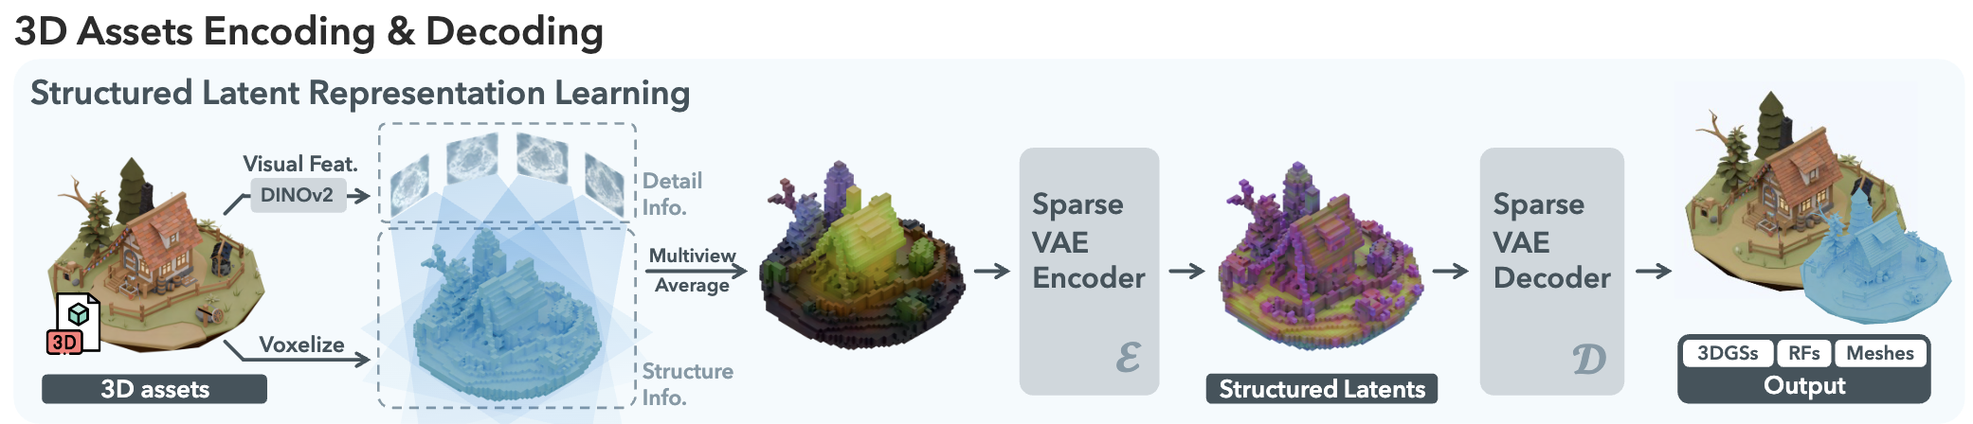
TRELLIS
CVPR25 SpotLight
Methods: 3D-VAE
3D Gaussians
Radiance Fields
Meshes

Slide 12
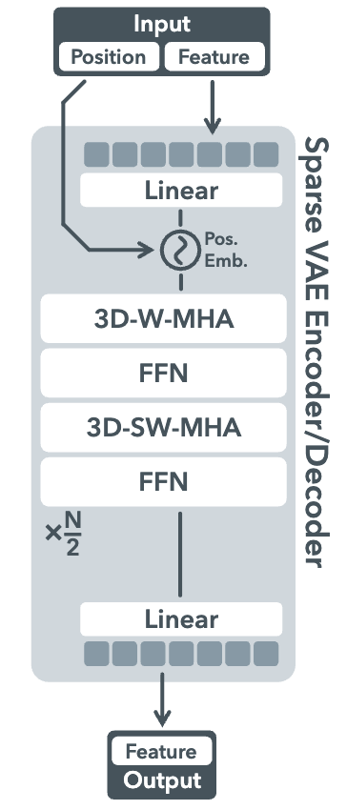
TRELLIS
CVPR25 SpotLight
Methods: 3D-VAE
3D-W-MHA: 3D windowed multi-head attention
3D-SW-MHA: 3D shift-windowed multi-head attention

Slide 13
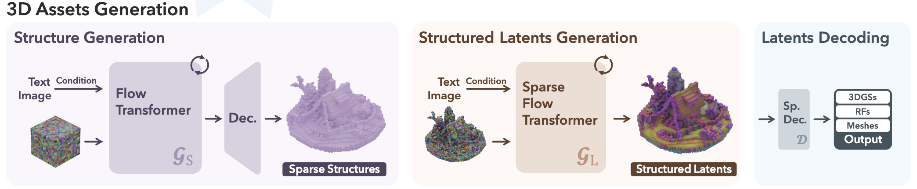
TRELLIS
CVPR25 SpotLight
Methods: 3D-assets Generation

Slide 14
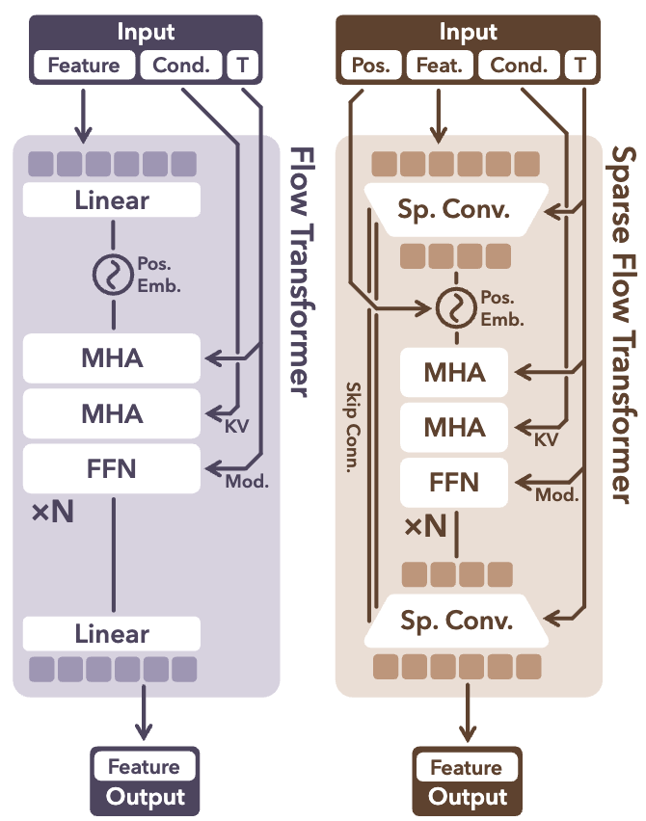
TRELLIS
CVPR25 SpotLight
Methods: 3D-assets Generation
Structure generation:
A small VAE + Flow Matching
Sparse Flow Transformer:
Shorten the length of sequence with 3D CNN + Flow Matching

Slide 15
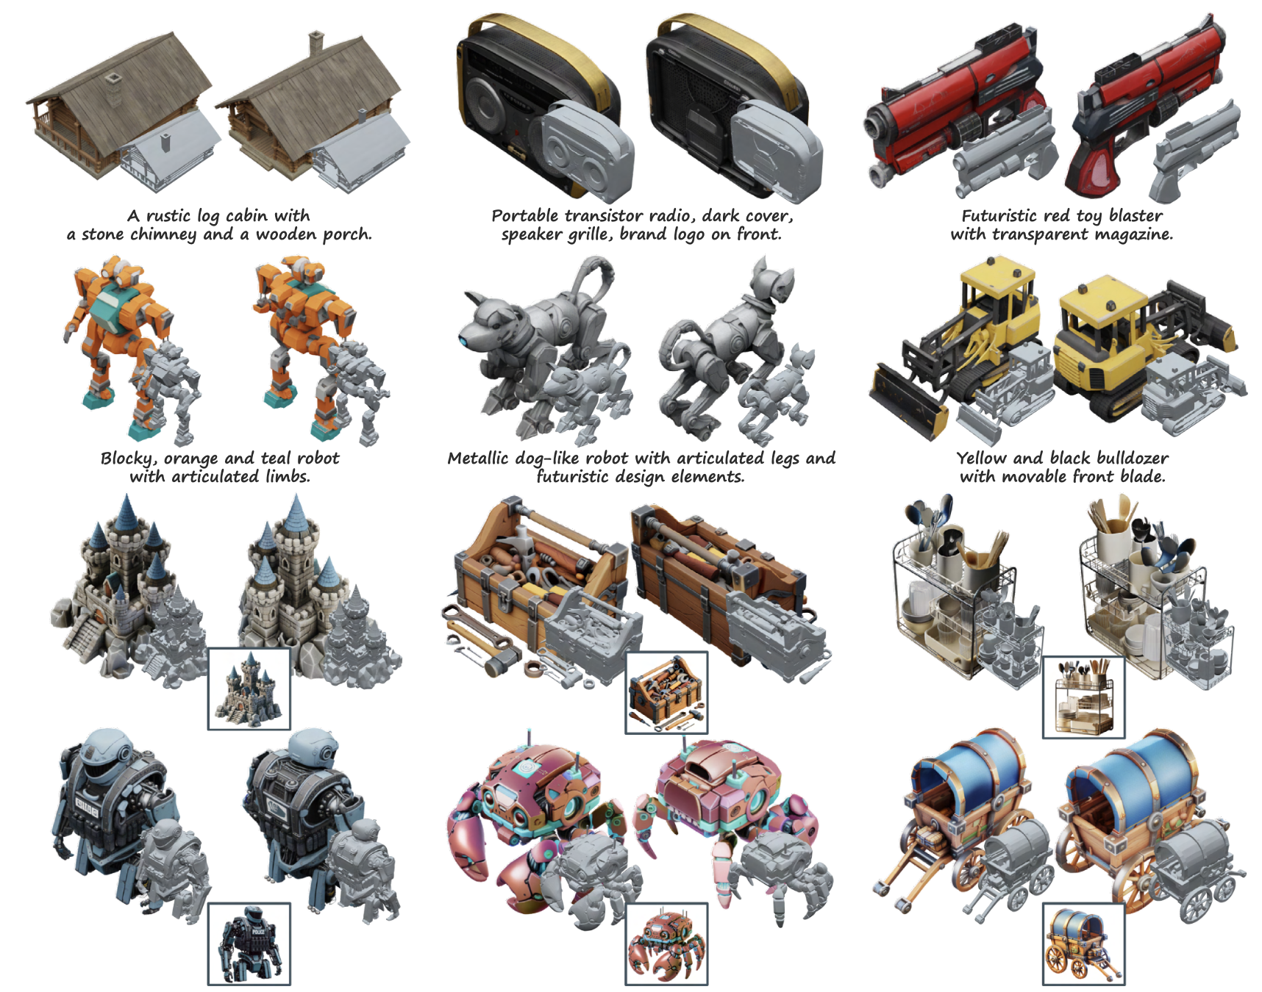
TRELLIS
CVPR25 SpotLight
Results

